Slide 1
MSE – 803 – Data Analytics
Week 9 – Activity 1
Fitness App
Andre Benedetti
17/04/2026

Slide 2
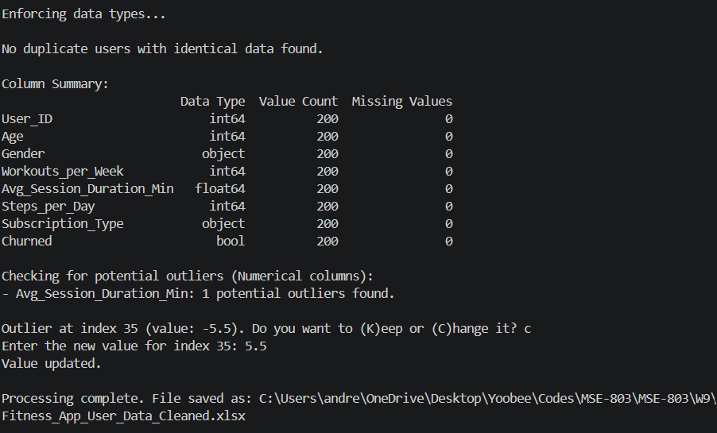
Data Clean
1 – Enforcing data type – churned was not bool.
2 – Checking for duplicate data (same age, gender, WpW, AVG SD, SpD, ST, and churned but different ID)
3 – Checking for outliers on the numerical comuns: found 1 with negative value for the AVG duration – value changed by user assuming that “-” was a typing error.
4 – Saved the cleaned data in a new file

Slide 3
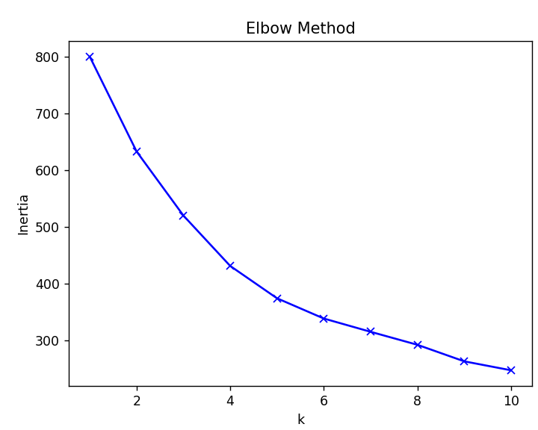
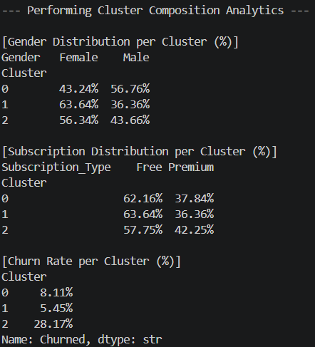
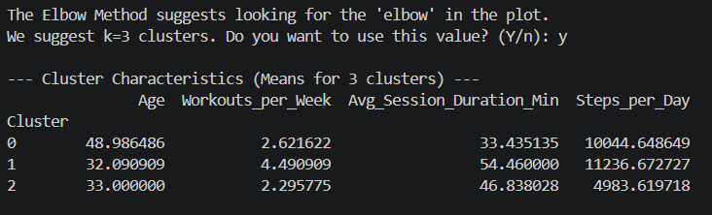
Clustering
1 – The Elbow method was used and the graph presented to user
2 – A suggested valeu o k was proposed and the user had the option to chage it
3 – With k = 3 there was 3 cluster:
Cluster 0 – Balance mature – Higher age, moderate exercise routing and high daily steps
Cluster 1 – Engaged athletes – Younger, highest trainning frequency, longer trainning duration
Cluster 2 – Potential sedentary users – Young, low tranning frequency, and low steps per day.

Slide 4
Cluster recommendations
Cluster 0 - Balance mature
With slight male predominance (57%), this group is physically active through lifestyle choices (walking) rather than intense app-based training. They are predominantly Free users (62%).
Since they are already active the app could introduce "Daily Step Goal" challenges to convert them to Premium. We can market the paid plan as a tool to better track and optimize the healthy activity they already perform.
Cluster 1 - The Engaged Athletes
With strong female predominance (64%), this group is the “power users”, who rely on the app as their primary fitness tool, but still 64% remain on the Free plan
This is our biggest revenue opportunity. Because they are already "hooked" on the app, you should target them with conversion campaigns highlighting "Premium features to take your training to the next level." They have already proven they need the app; now we just need to convert that usage into subscription revenue.
Cluster 2 - Potential Sedentary Users
With slight female predominance (56%), This group shows the least intense workout behavior. They have the highest adoption of the Premium plan among the three groups (42.%).
These may be users who subscribed to Premium hoping to build a habit but are struggling to follow through. The churn here is high. The app should provide motivational content, reminders, and "beginner-friendly" training plans to ensure they feel they are getting value from their subscription.

